Slide 1


Pneumatic Lift
Team Jantrik

Slide 2



Team Intro
Robotics Analyst
Gathering data for the robotic arm lifter
Analyzing the cost for the robot
Analyzing the energy consumption
CAD Design Engineer
Gathering Computer Aided Designs examples
Assembling the Robot arm
Robotics System Engineer
Making a pneumatic system
Implementation of internal operation of the system
Analyzing efficiency of the robot

Slide 3
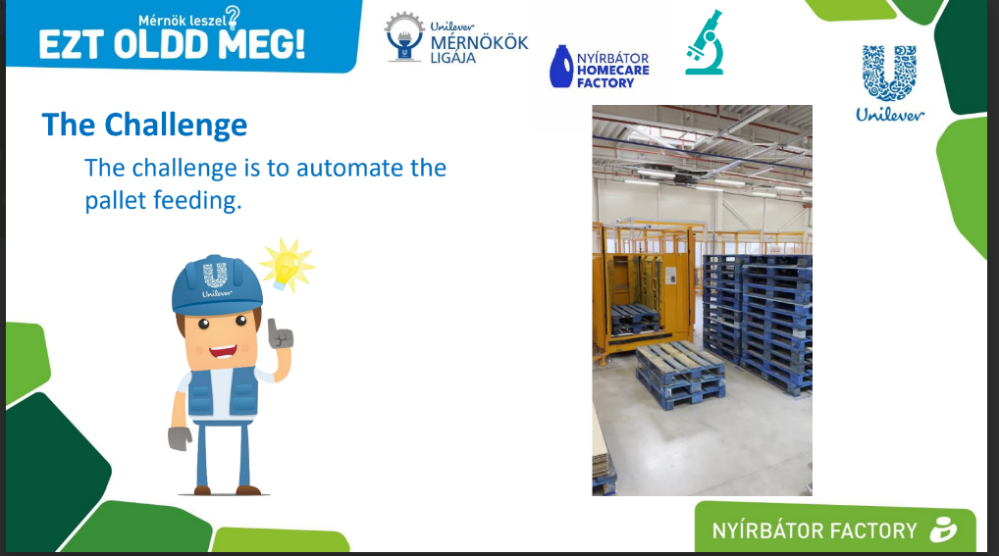
Problem
Automated pallet feeding

Slide 4
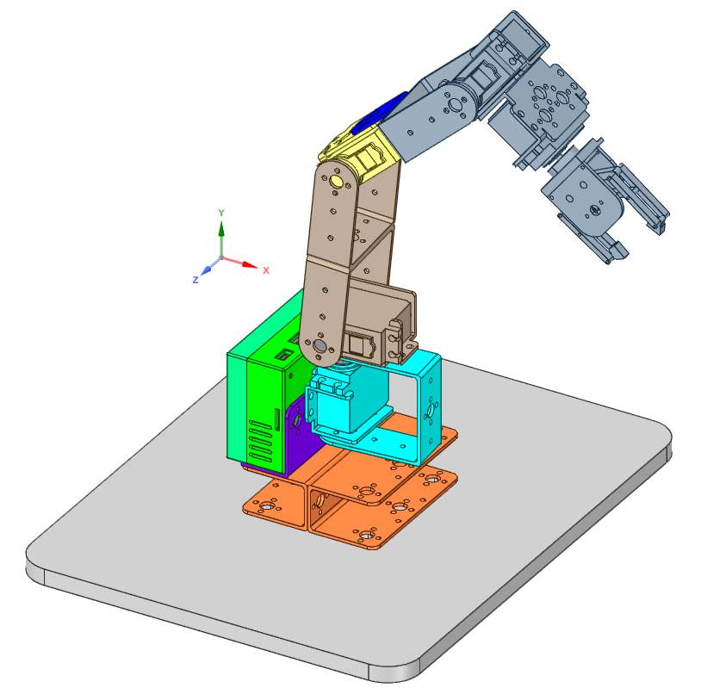
Our solution
Using electro-pneumatic system in a robot arm with clamp-claw
Rotary Robotic Arm
Mechanical Body- Suitable for less space to move
Linear Robotic Arm
Electropneumatic body- Suitable for less energy to perform

Slide 5
Operational Process
Start
Activate rotor 2 of claw to insert under 4 pcs and grab and lift the stack
Initiate Rotor and rotate 30 degree
Distance from claw to pallet
Capacitive sensor 2 checks distance to drop
Ultrasonic Sensor
YES
Activate linear cylinder to move from stack to feeder and unload
Activate Sensor
If the distance is more, rotate closer to drop
Capacitive Sensor
Checks if the pallet in sensor radius
NO
Complete the cycle 3 times
Timer set to 5 minutes to reload the stock to feed
Repeat the process after the time of reloading

Slide 6
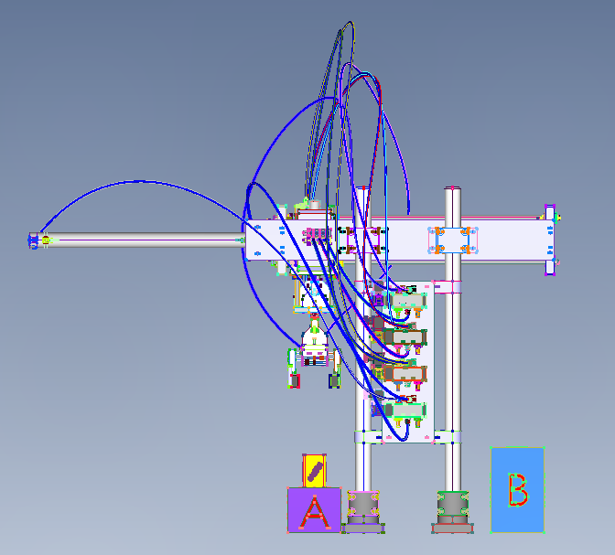
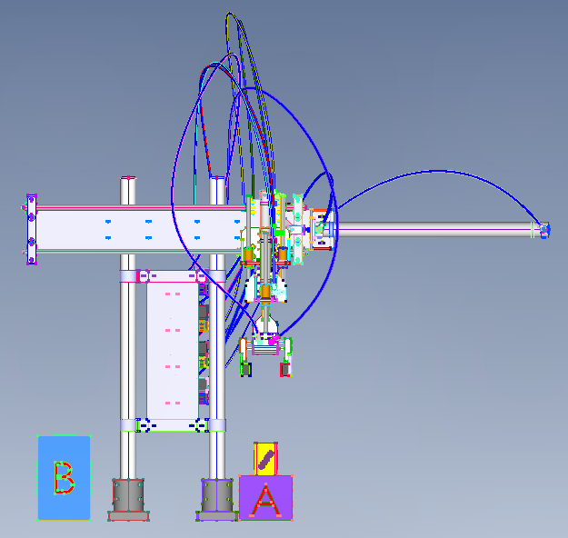
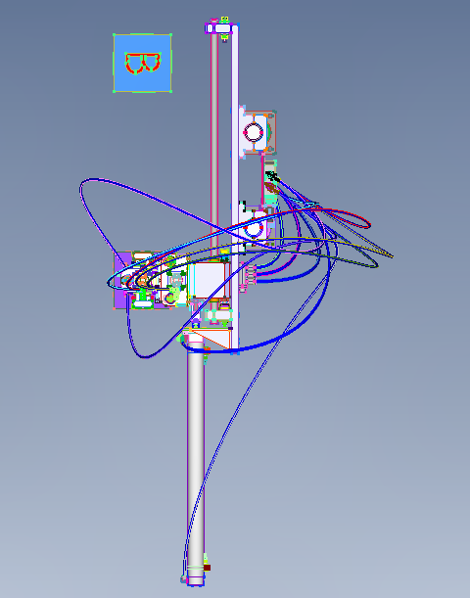
Technological Solutions Linear Robotic Arm
Left View
Right View
Top View

Slide 7
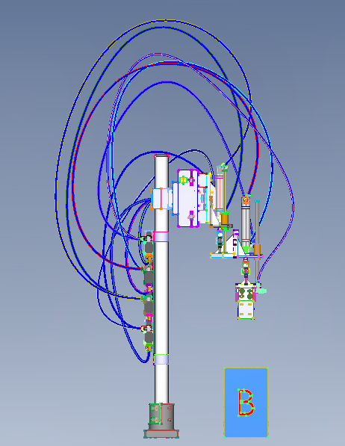
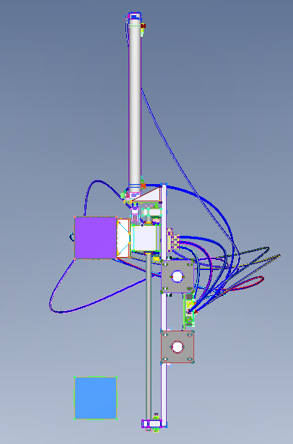
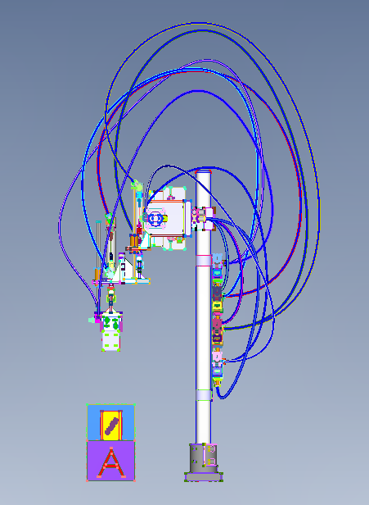
Technological Solutions Linear Robotic Arm
Back View
Bottom View
Front View

Slide 8
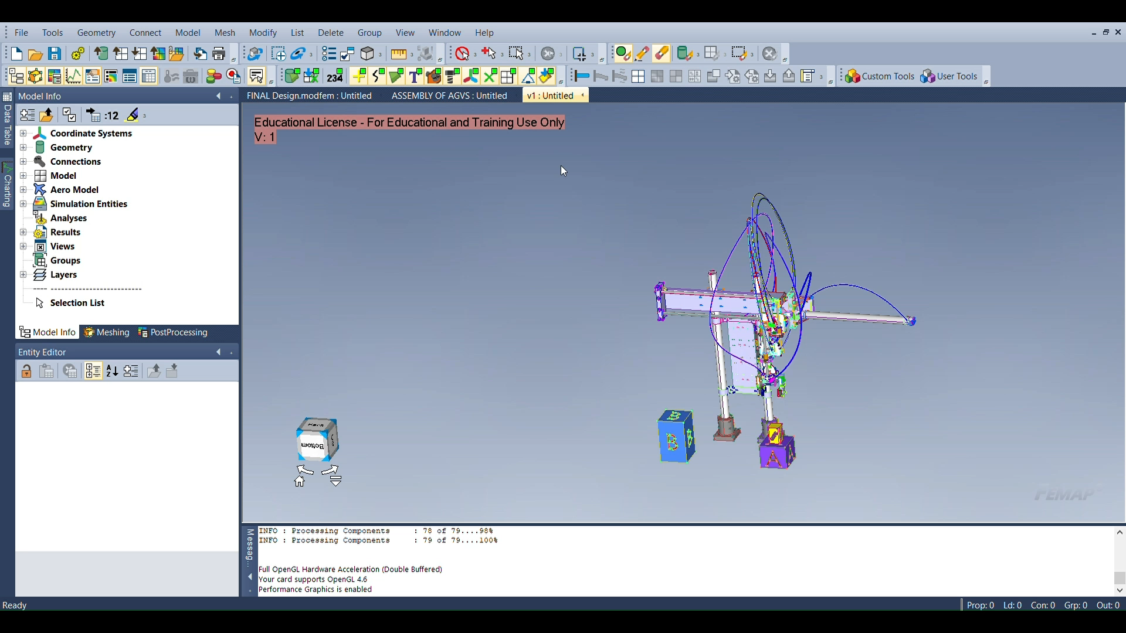
Technological Solutions Linear Robotic Arm

Slide 9
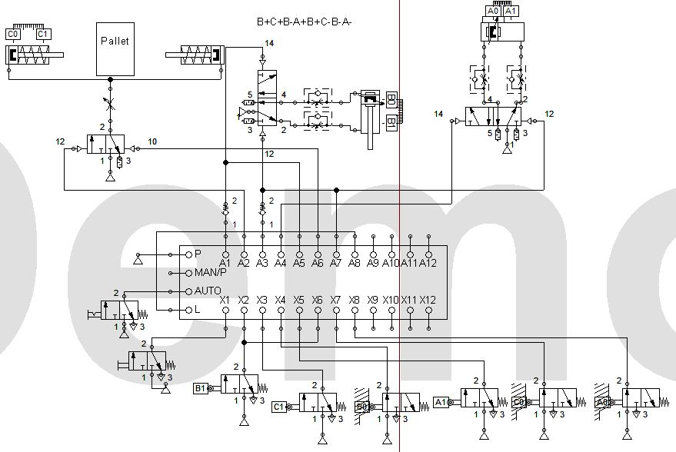
Technological Solutions Linear Robotic Arm

Slide 10
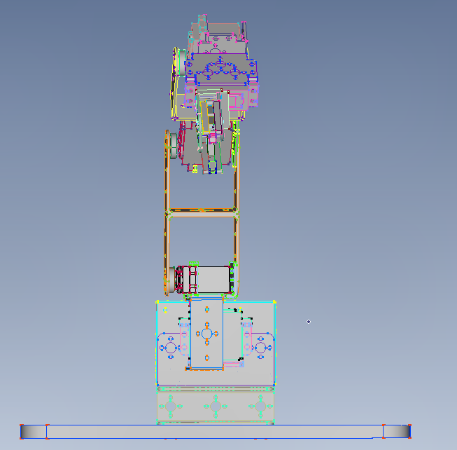
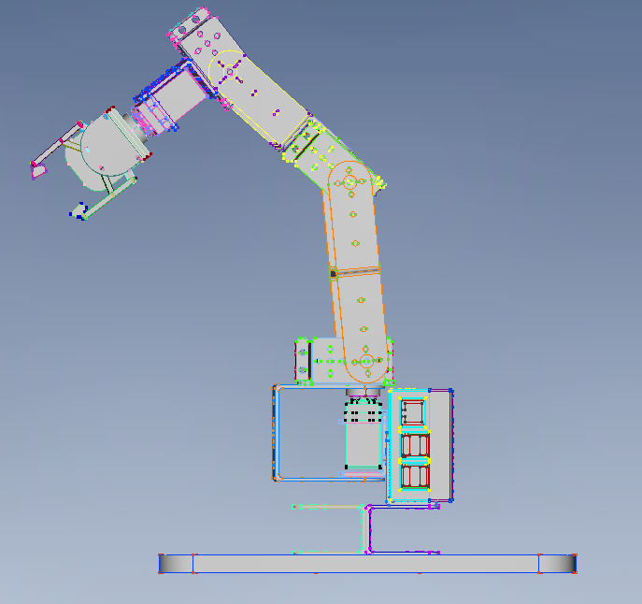
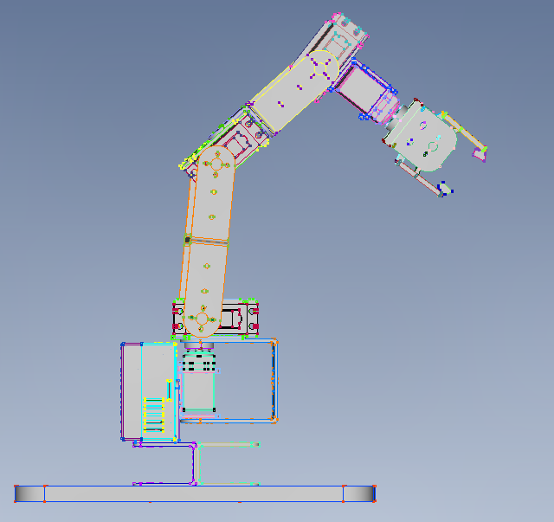
Technological Solutions Rotary Robotic Arm
Front View
Left View
Right View

Slide 11
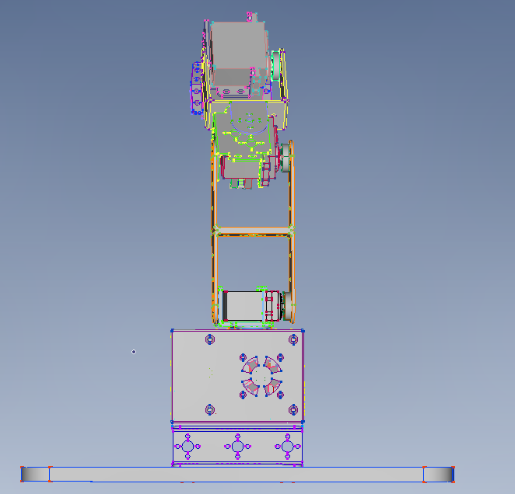
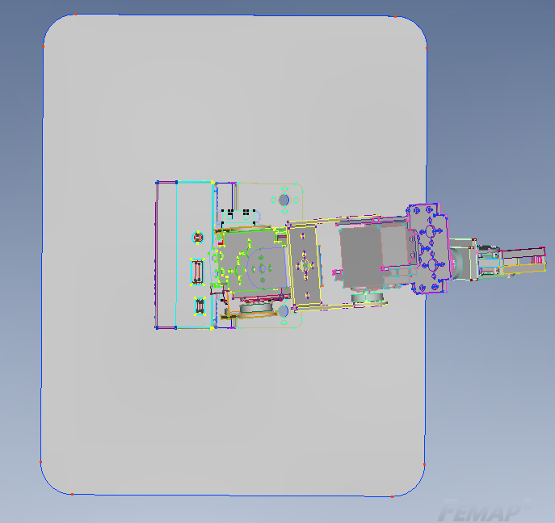
Technological Solutions Rotary Robotic Arm
Back View
Top View

Slide 12
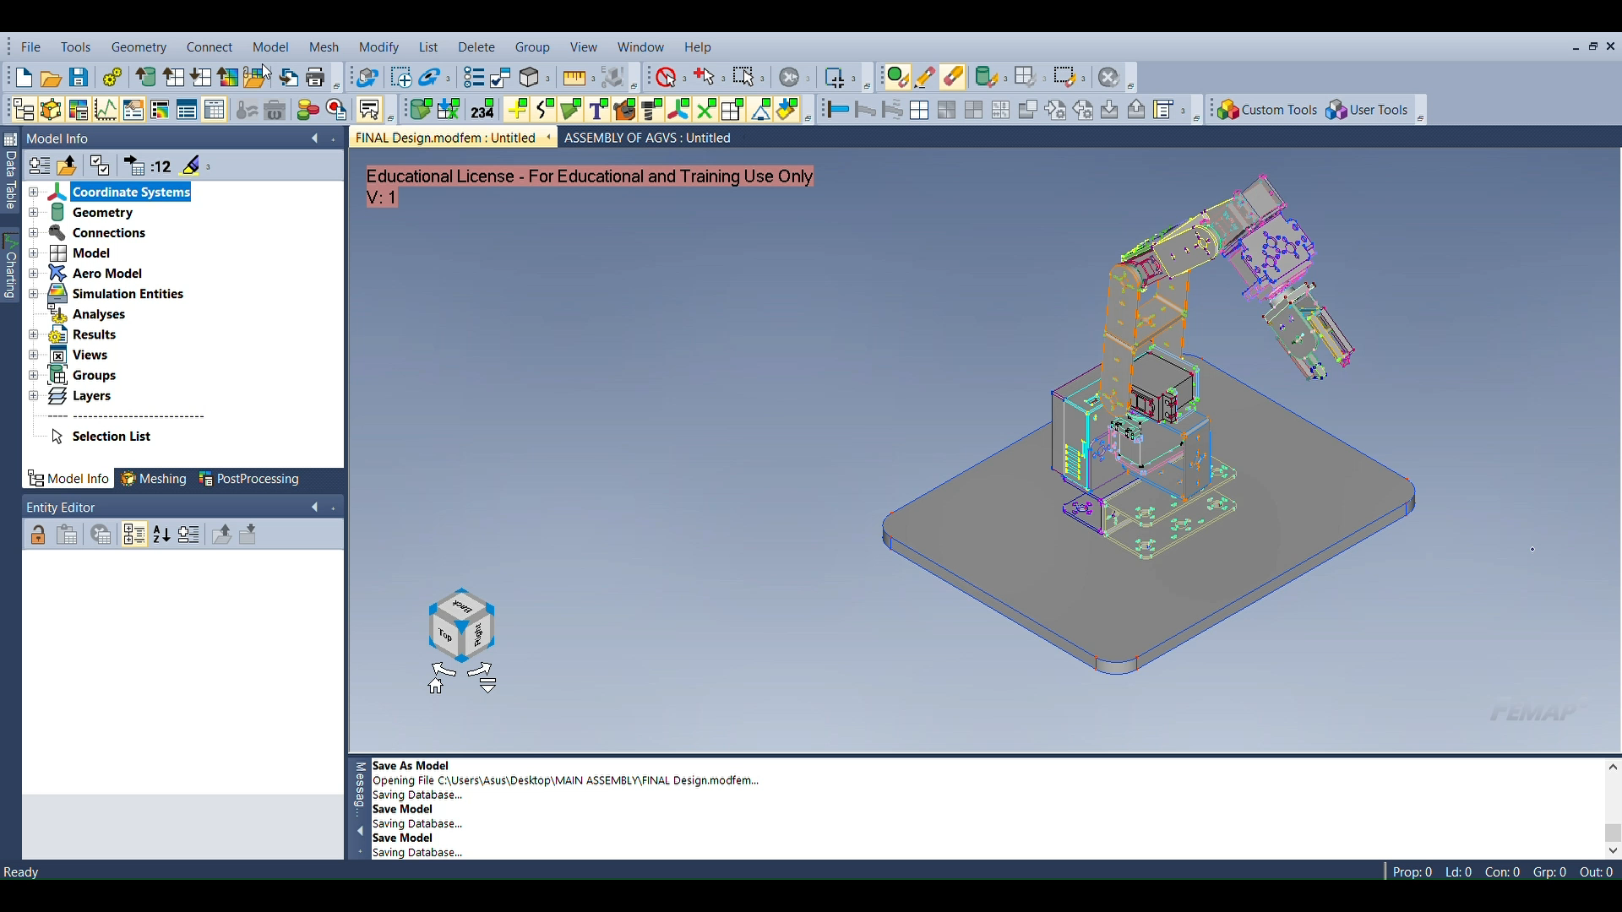
Technological Solutions Rotary Robotic Arm

Slide 13
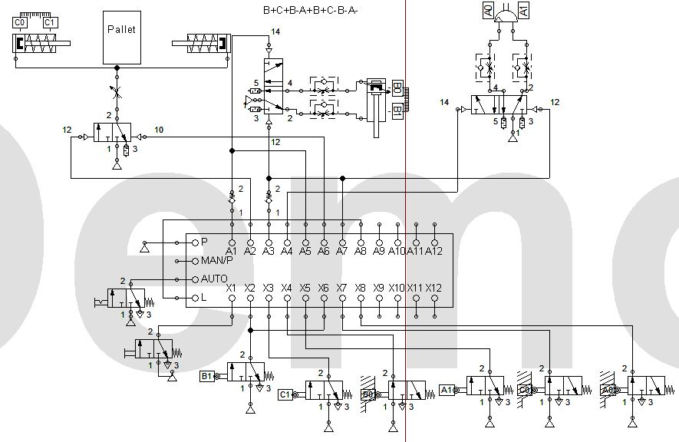
Technological Solutions Rotary Robotic Arm
Using
Quick-stepper

Slide 14
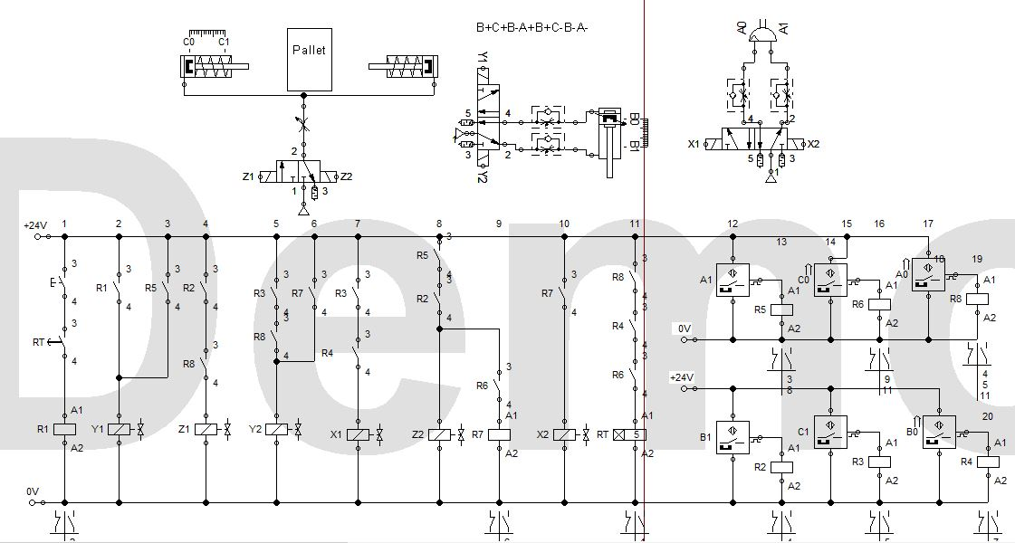
Technological Solutions Rotary Robotic Arm
Using
Relay

Slide 15
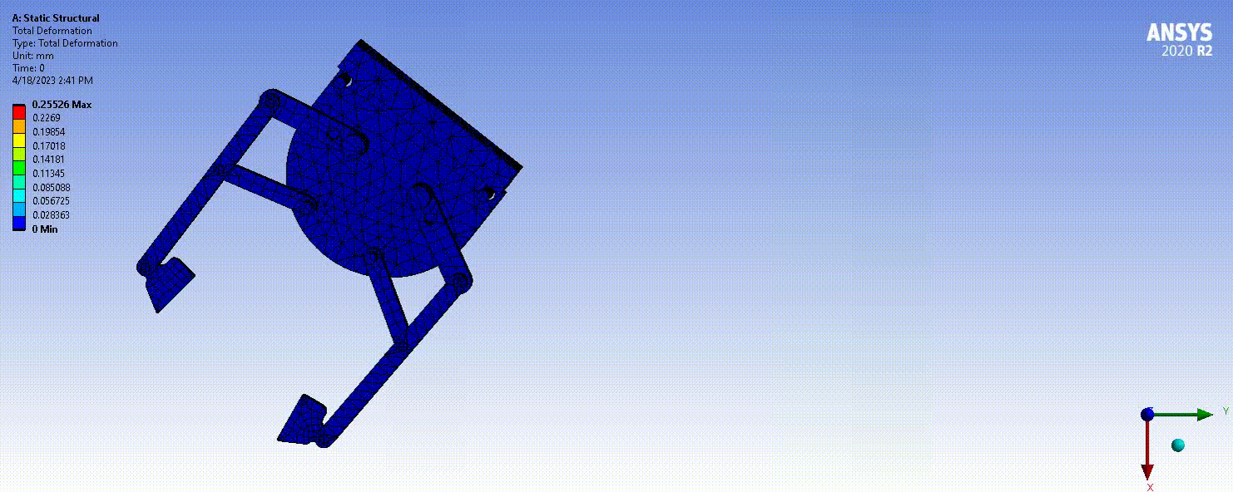
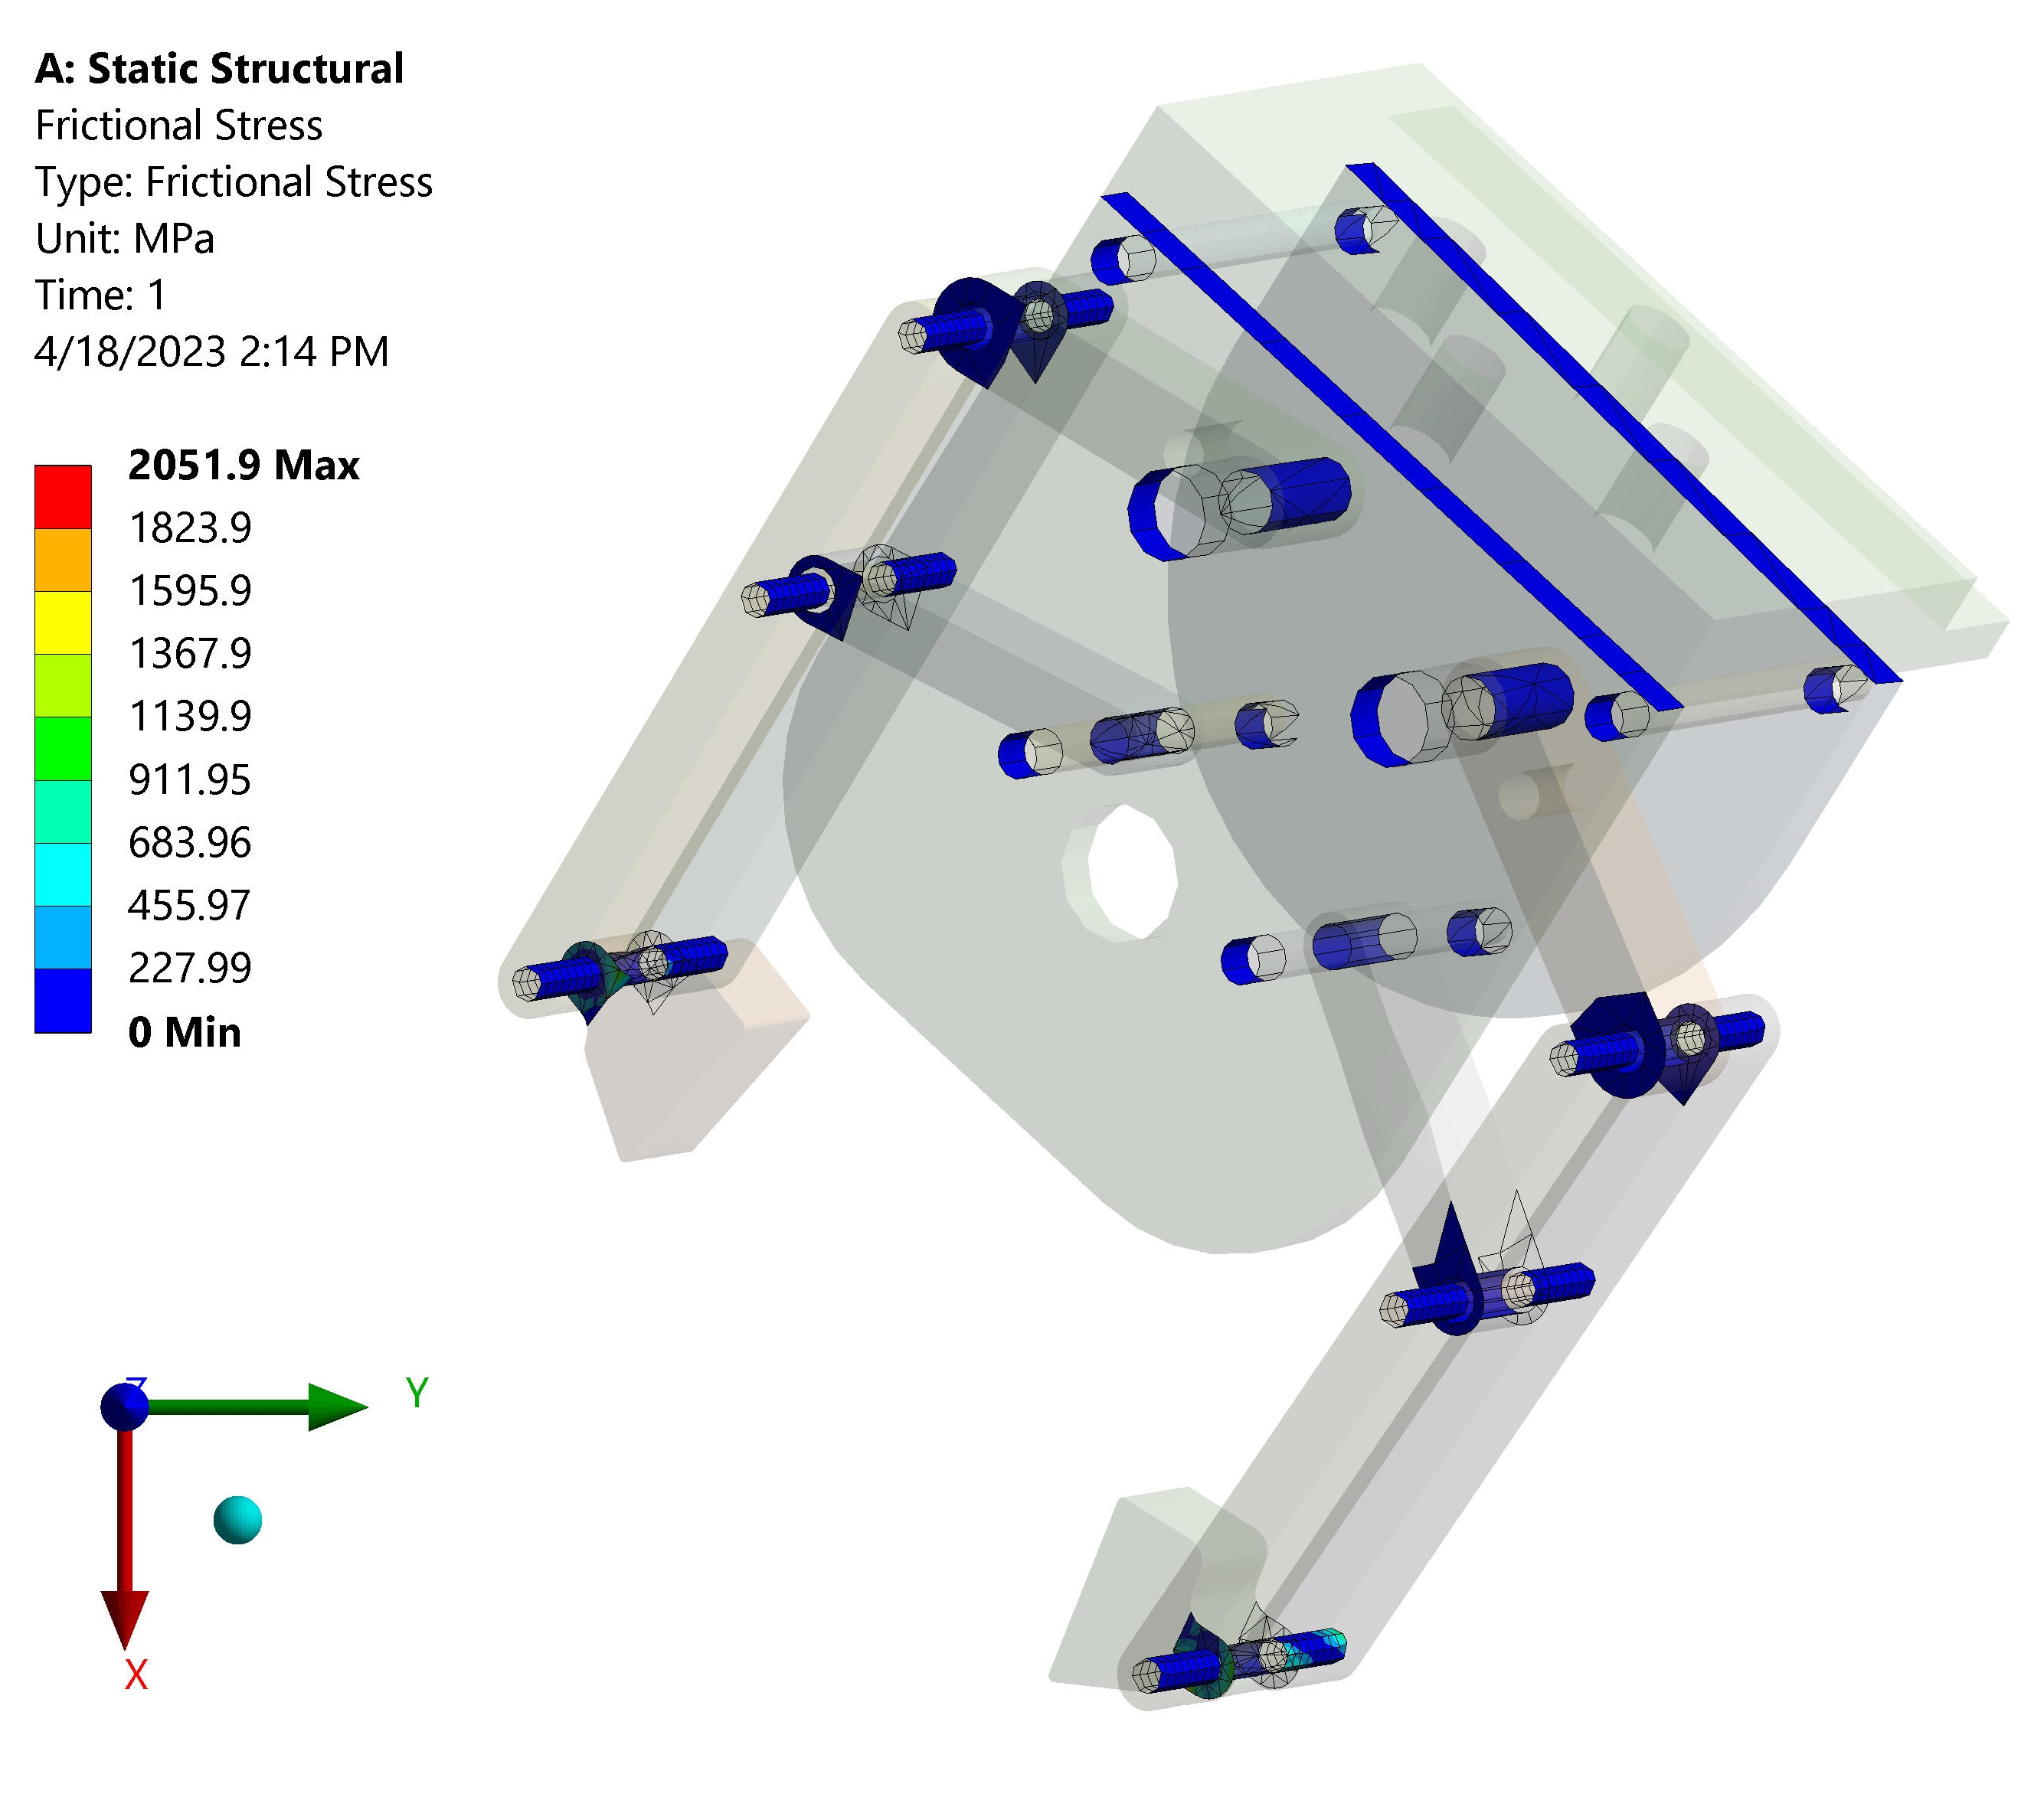
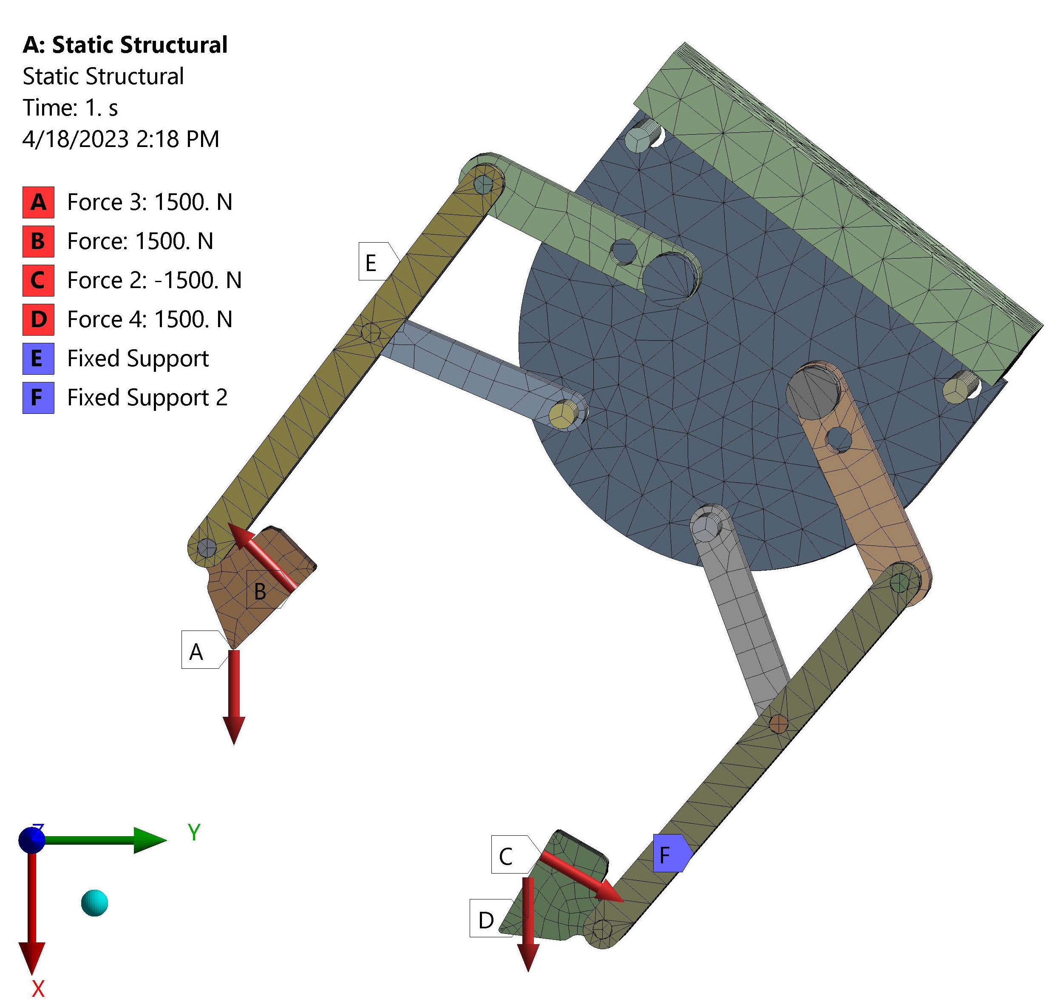
Deformation of claw
Deformation Distribution
Frictional Contact Stress
FE model forces and constraints

Slide 16
Expected Benefits
Less time
More efficiency
Less energy consumption
No manual labor
Quality
No human errors
Less accidents
More controllable
Safety
Cost
Less expensive than hydraulic or electrical systems
Cheaper energy source
Comparatively budget friendly management

Slide 17



Cost –Time-Energy Analysis
25k - 40k USD
45-50 Secs per batch of 4 pallets
2-4kW for the arm to operate
Weight of the pallets and the robotic arm:
Assuming the total weight of the pallets and the robotic arm is around 370-470 kg
Distance between the center of gravity of the load and the axis of rotation
Assuming the center of gravity of the load is at a distance of 50 cm from the axis of rotation.
Torque = (Weight of the load + Weight of the robotic arm) * Distance * Acceleration due to gravity
= ((120 + 370-470) kg * 0.5 m * 9.81 m/s^2)= 588-735 Nm

Slide 18
References
For the CAD designs
https://grabcad.com/library/pick-and-place-3-dual-stroke-pneumatic-cylinder
https://grabcad.com/library/robot-arm-6-axes-prototype-1
For the Design concept
https://youtu.be/0ULSCdUnCHE
For the Price comparison
https://www.ufactory.cc/the-most-affordable-collaborative-robots-comparison2?gclid=CjwKCAjw__ihBhADEiwAXEazJhaP1n1jE1r1osqE95RTM_ePLh34btP5JCogT6_IpjLuND4TytDh9xoCK8gQAvD_BwE
https://unchainedrobotics.de/en/category/robot?gclid=CjwKCAjw__ihBhADEiwAXEazJhwpuetSYVpEdtJtHs8anPCUP3S3_c6aYClsN3SB6gSLjR3sYeajYBoCxU4QAvD_BwE
Consultant
Rashwan Al Kentar (Ph.D. Engineering Science, Informatics, University of Debrecen)
József Kertész (Teaching Assistant, Faculty of Technology, University of Debrecen)

Slide 19

Thank you

